Slide 1
ESc201 : Introduction to Electronics
Logic Gates and Minimization
Vipul Arora
Dept. of Electrical Engineering
IIT Kanpur
Mar 29, 2023

Slide 2
3-variable minimization (recap)
Cover all the 1’s with as few groups as possible

Slide 3
3-variable minimization (recap)

Slide 4
3-variable minimization (recap)

Slide 6
4-variable minimization
Is this the simplest expression ?

Slide 8
4-variable minimization
Is this the best that we can do ?

Slide 9
Cover the 1’s with minimum number of terms

Slide 10
4-variable minimization

Slide 11
Groups of 4

Slide 13
Groups of 8

Slide 14
Examples

Slide 15
Don’t care terms

Slide 16
Don’t care terms can be chosen as 0 or 1. Depending on the problem, we can choose the don’t care term as 1 and use it to obtain a simpler Boolean expression
Don’t care terms should only be included in encirclements if it helps in obtaining a larger grouping or smaller number of groups.

Slide 17
SOP/POS form (recap)
Sum of Products (SOP) form
Product of Sum (POS) form

Slide 18

What is different in PoS Representation?
Replace 1 with 0
i.e., x represents 0
Replace $⋅$ with $+$ and vice versa

Slide 19
Minimization of Product of Sum Terms using Kmap

Slide 22
Example
Obtain the minimized PoS by suitably using don’t care terms

Slide 23
Implementation with Gates

Slide 24
Design Flow
System Description
Truth Table
Boolean Expression
Minimized
Boolean Expression
Gate Netlist

Slide 25
Mapping of Boolean expression to a Network of gates available in the library

Slide 26
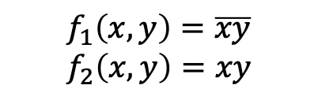

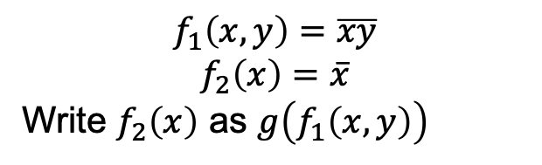


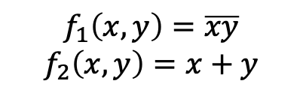
Implementation using only NAND gates
NAND to Inverter
$$f_{1}\left(x,y\right)=\overline{xy}$$
$$f_{2}\left(x\right)=\overline{x}$$
Write $f_{2}\left(x\right)$ as $g\left(f_{1}\left(x,y\right)\right)$
$$f_{2}\left(x\right)=f_{1}(x,x)$$
NAND to AND
$$f_{1}\left(x,y\right)=\overline{xy}$$
$$f_{2}\left(x,y\right)=xy$$
$$f_{2}\left(x,y\right)=f_{1}(f_{1}\left(x,y\right),f_{1}\left(x,y\right))$$
NAND to OR
$$f_{1}\left(x,y\right)=\overline{xy}$$
$$f_{2}\left(x,y\right)=x+y$$
$$f_{2}\left(x,y\right)=\overline{\overline{x} \overline{y}}=f_{1}\left(\overline{x},\overline{y}\right)$$
$$=f_{1}(f_{1}\left(x,x\right),f_{1}\left(y,y\right))$$

Slide 27
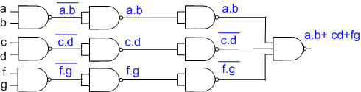
Implementation using only NAND gates
A SoP expression is easily implemented with NAND gates.
AND
OR

Slide 28
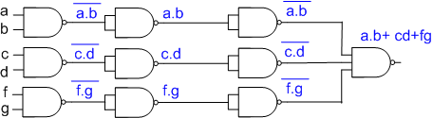
There is a one-to-one mapping between
AND-OR network and NAND network

Slide 29
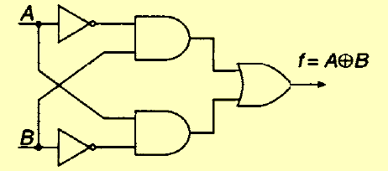
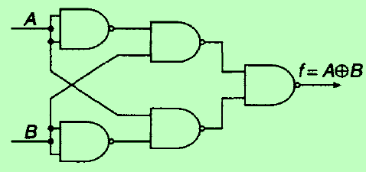
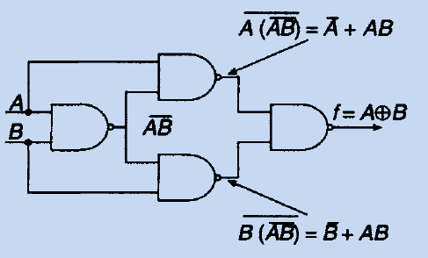
Often there is lot of further optimization that can be done
Consider implementation of XOR gate

Slide 30

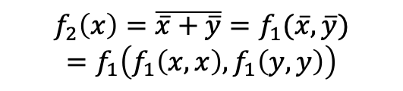
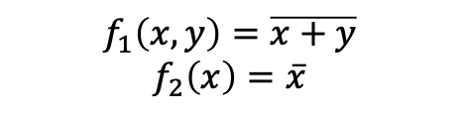
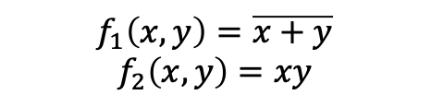

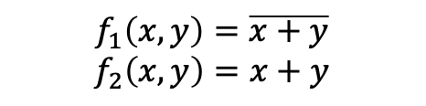
Implementation using only NOR gates
NOR to Inverter
$$f_{1}\left(x,y\right)=\overline{x+y}$$
$$f_{2}\left(x\right)=\overline{x}$$
$$f_{2}\left(x\right)=f_{1}(x,x)$$
NOR to OR
$$f_{1}\left(x,y\right)=\overline{x+y}$$
$$f_{2}\left(x,y\right)=x+y$$
$$f_{2}\left(x\right)=f_{1}\left(f_{1}\left(x,y\right),f_{1}\left(x,y\right)\right)$$
NOR to AND
$$f_{1}\left(x,y\right)=\overline{x+y}$$
$$f_{2}\left(x,y\right)=xy$$
$$f_{2}\left(x\right)=\overline{\overline{x}+\overline{y}}=f_{1}(\overline{x},\overline{y})$$
$$=f_{1}\left(f_{1}\left(x,x\right),f_{1}\left(y,y\right)\right)$$

Slide 31
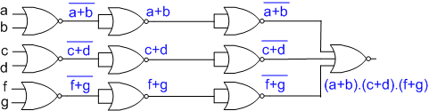
Implementation using only NOR gates
To implement using NOR gates, it is easiest to start with minimized Boolean expression in POS form
OR
AND

Slide 32
There is a one-to-one mapping between
OR-AND network and NOR network

Slide 33
Summary
AND-OR NAND
SoP form
OR-AND NOR
PoS form

Slide 34
To implement SoP expression using NOR gates, determine first the corresponding PoS expression and then follow the procedure outlined earlier
Similarly PoS expression can be implemented as NAND network by first converting it to SoP expression and then following the procedure outlined earlier

Slide 35
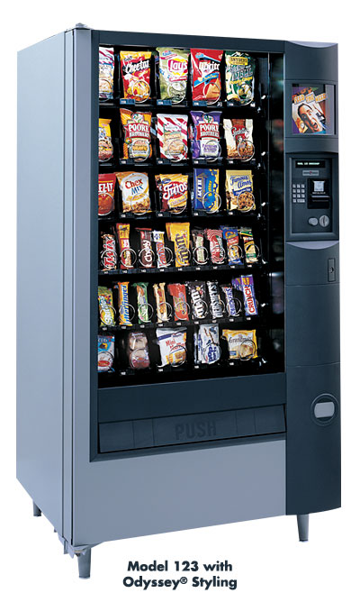
How do we get the chocolate?

